Slide 1


SUPPLY CHAIN EFFICIENCY & LEAD TIME OPTIMIZATION
Identifying the Mid-Mile Bottleneck in NE India Logistics
Analyst : Bhuvaneshwari Vijay Raghavan | June 2026

Slide 2

THE PROBLEM
Shipments from Indian warehouses to North-East states are consistently delayed - causing high Return-to-Origin (RTO) rates and customer dissatisfaction.
NE India serves 8 states with challenging terrain and limited infrastructure
Logistics providers publish SLA targets of 7–9 days for NE India vs 2 days for Metro
The question: Is the delay at the Origin Warehouse, Mid-Mile Transit or Last Mile delivery?
Data Source: Synthetic data modeled on Delhivery published SLA benchmarks | Jan–May 2026 | 85 shipments across 20 zones

Slide 3
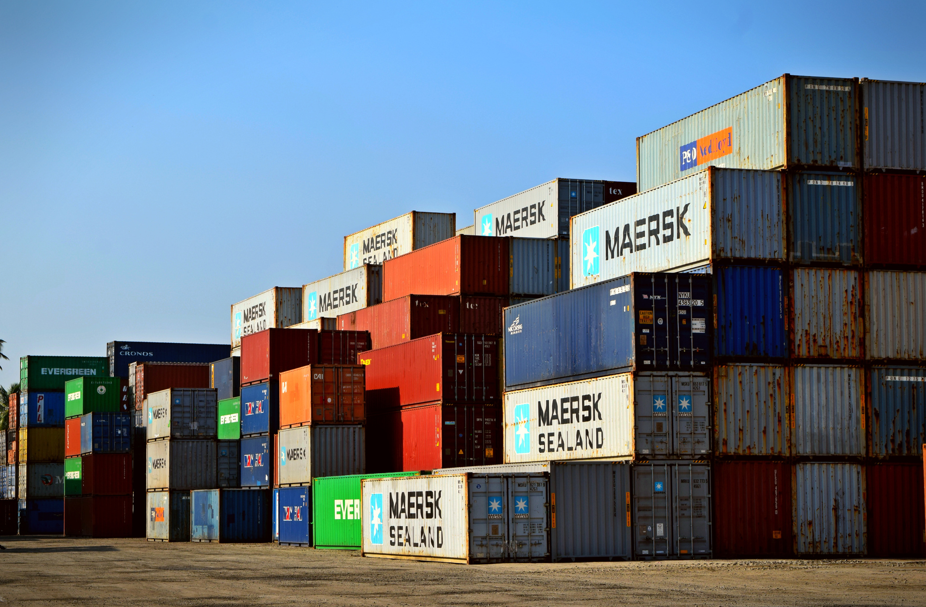
KEY FINDINGS
109 hrs
Avg Mid-Mile Transit - NE India
6.8x
Slower than Metro (16 hrs)
28%
RTO Rate - NE India vs 0% Metro
Analysis based on 85 shipments across 20 zones | Jan–May 26

Slide 4
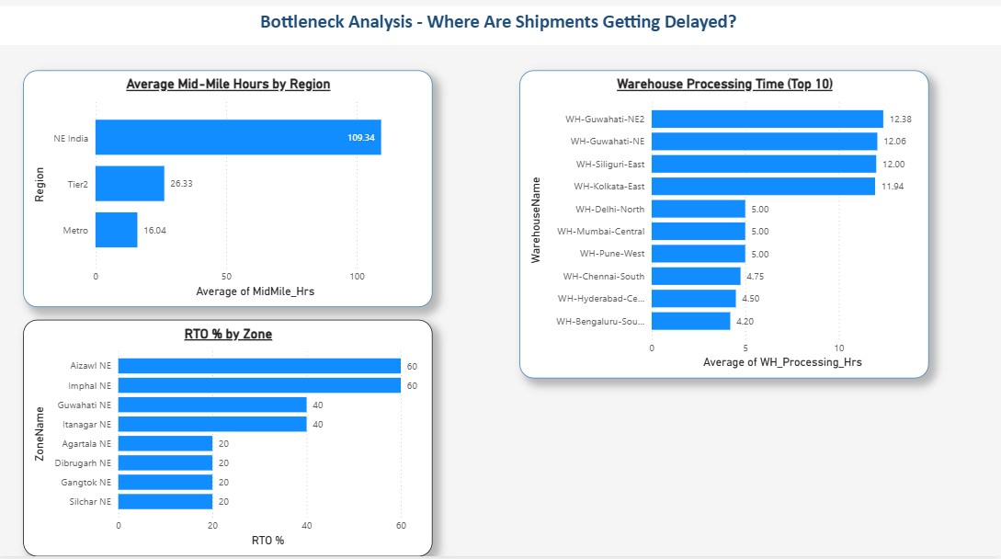
THE BOTTLENECK: MID-MILE TRANSIT
Stage 1 - Warehousing Processing : 12 hrs (NE) vs 4.5 hrs (Metro)
Stage 2 - Mid-Mile Transit : 109 hrs (NE) vs 16 hrs (Metro) ← BOTTLENECK
Stage 3 - Last Mile : 51 hrs (NE) vs 8 hrs (Metro)
Worst zones: Aizawl & Imphal - 60% RTO Rate

Slide 5
RECOMMENDATIONS
🔴 Priority 1 - Fix Mid-Mile Infrastructure
Invest in dedicated NE India transit hubs at Guwahati & Siliguri to reduce 109-hr avg to under 48 hrs
📦 Priority 2 - Address Aizawl & Imphal
60% RTO zones need hyperlocal delivery partners - national courier SLAs are not viable
📊 Priority 3 - Real-Time SLA Monitoring
Implement zone-wise dashboards to flag Mid-Mile delays before they become RTOs
💰 Priority 4 - RTO Cost Recovery
28% NE India RTO rate represents significant reverse logistics cost - negotiate RTO insurance with courier partners
Implementing these changes could reduce NE India RTO rate from 28% to under 10%

Slide 6
THANK YOU
Bhuvaneshwari Vijay Raghavan
BI & Data Analytics | Gen AI Enabled
🔗 LinkedIn : linkedin.com/in/bhuvaneshwari-vijay
💻 GitHub : github.com/bhuvaneshwari-vijay
🌐 Portfolio : bhuvaneshwari-vijay-portfolio.tiiny.site

